Slide 1

REPUBLIC ACT NO. 6713
Code of Conduct & Ethical Standards for Public Officials and Employees

Slide 2

Constitutional Basis:
Article XI of the 1987
Constitution
Section 1. Public office is a public trust. Public officers and employees must, at all times, be accountable to the people, serve them with utmost responsibility, integrity, loyalty, and efficiency; act with patriotism and justice, and lead modest lives.
(ACCOUNTABILITY OF PUBLIC OFFICERS)

Slide 3
Coverage
All officials and employees in the government - elective and appointive, permanent or temporary, whether in the career service or non-career service, including military and police personnel, whether or not they receive compensation, regardless of amount. (Sec. 1 Rule 1, Rules)

Slide 4
Declaration of Policy
It is the policy of the State to promote a high standard of ethics in public service. Public officials and employees shall at all times be accountable to the people and shall discharge their duties with utmost responsibility, integrity, competence and loyalty, act with patriotism and justice, lead modest lives, and uphold public interest over personal interest. (Sec. 2 RA 6713)

Slide 5
Components:
Norms of Conduct
Duties of Public Officials & Employees
Prohibited Acts & Transactions

Slide 6

NORMS OF CONDUCT

Slide 7

Commitment to Public Service
Uphold public interest over personal interest
Employ and use efficiently, effectively, honestly and economically all office resources and powers

Slide 8

Professionalism
Discharge duties with highest degree of excellence, intelligence and skill
Enter public service with utmost devotion and dedication to duty
Discourage wrong perceptions of your roles as dispenser or peddlers of undue patronage

Slide 9
Justness & Sincerity
Remain always true to the people
Do not discriminate against anyone especially the poor and the underprivileged
Respect at all times the rights of others
Refrain from doing acts contrary to law, good morals, good customs, public policy, public order, public safety and public interest
Do not dispense/extend undue favors on account of your office to your relatives

Slide 10

Political Neutrality
Provide service to everyone without unfair discrimination and regardless of party affiliation and preference

Slide 11

Responsiveness to the Public
Extend prompt, courteous and adequate service to the public
Unless provided by law, provide information on office policies, procedures and ensure openness of information, public consultations and hearings when appropriate, encourage suggestions, simplify and systematize policies, rules and procedures
Avoid red tape and develop an understanding and appreciation of the socio-economic conditions prevailing in the country

Slide 12
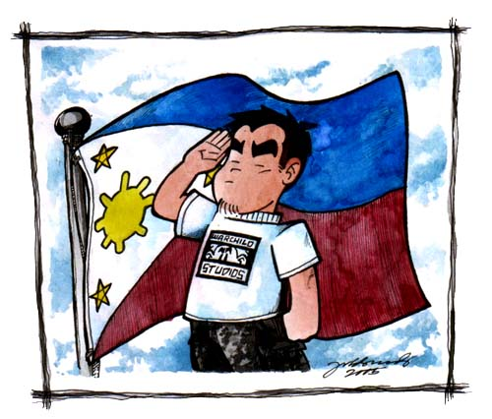
Nationalism & Patriotism
Be loyal to the Republic and to the Filipino people at all times
Promote use of locally produced goods, resources and technology
Encourage appreciation and pride of country and people
Maintain and defend Philippine sovereignty against foreign intrusion

Slide 13

Commitment to Democracy
Commit yourself to the democratic way of life and values, maintain the principle of public accountability and manifest by deeds the supremacy of civilian authority over the military
Uphold the Constitution and put loyalty to country above loyalty to persons or party

Slide 14

Simple Living
Lead modest lives appropriate to position and income
Do not indulge in extravagant or ostentatious display of wealth

Slide 15
DUTIES OF PUBLIC OFFICIALS & EMPLOYEES
Act promptly on letters & requests
Submit annual performance reports
Process documents and papers expeditiously
Act immediately on public personal transaction
Make documents accessible to the public

Slide 16
PROHIBITED ACTS & TRANSACTIONS
Financial and material interest
Outside employment and activities related thereto
Solicitation and acceptance of gift

Slide 17

“GIFT”
  - a thing or a right disposed of gratuitously, or any act of liberality, in favor of another who accepts it, and shall include a simulated sale or an ostensibly onerous disposition thereof. It shall not include an unsolicited gift of nominal or insignificant value not given in anticipation of, or in exchange for, a favor from a public official or employee

Slide 18

“receiving any gift”
includes the act of accepting, directly or indirectly, a gift from a person other than a member of his family or relative as defined in this Act, even on the occasion of a family celebration or national festivity like Christmas, if the value of the gift is neither nominal or insignificant, or the gift is given in anticipation of, or in exchange for, a favor

Slide 19
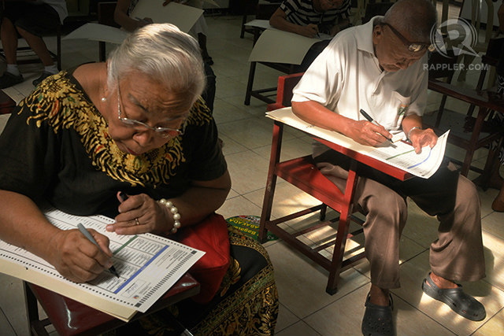

Slide 20


Slide 21


Slide 22


Slide 23
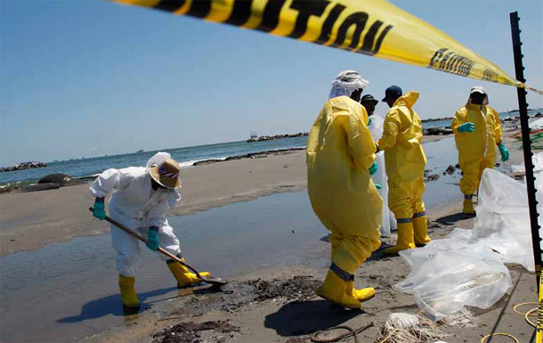

Slide 24


Slide 25
REPUBLIKA NG PILIPINAS
PANUNUMPA SA KATUNGKULAN
Ako, si __________________________________ ng ___________________ na (hinirang/itinalaga) sa katungkulan bilang _________________________ ay taimtim na nanunumpa na tutuparin kong buong husay at katapatan, sa abot ng aking kakayahan, ang mga tungkulin ng aking kasalukuyang katungkulan at ng mga iba pang pagkaraan nito’y gagampanan ko sa ilalim ng Republika ng Pilipinas; na aking itataguyod at ipagtatanggol ang Konstitusyon ng Pilipinas; na tunay na mananalig at tatalima ako rito; na susundin ko ang mga batas, mga kautusang legal, at mga dekretong pinaiiral ng mga sadyang itinakdang may kapangyarihan ng Republika ng Pilipinas; at kusa kung babalikatin ng pananagutang ito, nang walang ano mang pasubali o hangaring umiwas.
Kasihan Nawa Ako ng Diyos.

